Slide 1
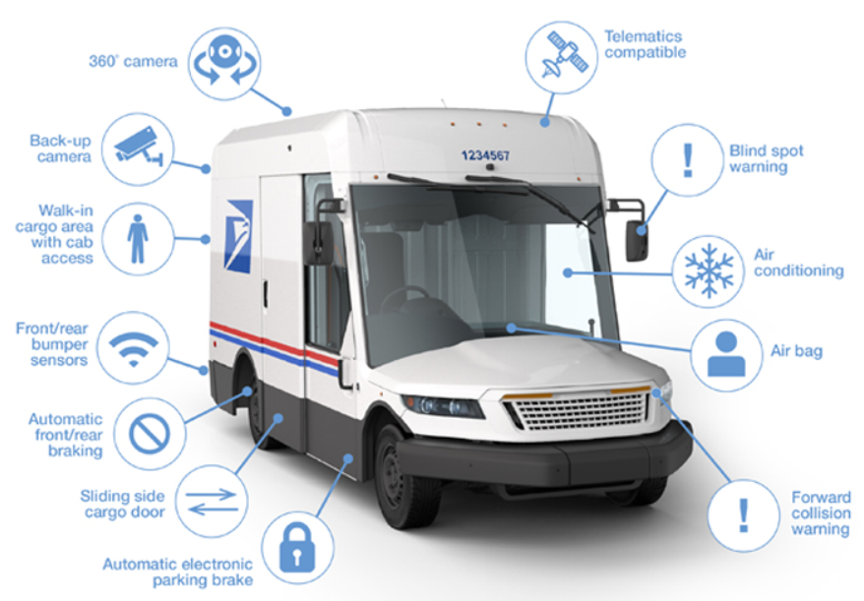

Slide 2
New Postal Vehicles
Coming Soon to Your Neighborhood
The Postal Service has awarded a 10-year contract to
Oshkosh Defense to manufacture a new generation of
U.S-built delivery vehicles that will drive the most dramatic modernization of the USPS fleet in three decades.
The historic investment is part of a soon-to-be-released
plan the Postal Service has developed to transform its
financial performance and customer service during the
next decade through significant investments in people, technology and infrastructure as it seeks to become the preferred delivery service provider for the American public.
To view the video, click on this link: https://link.usps.com/2021/02/24/vehicles-video/

